Slide 1
Clinical Practice Guidelines
HEV

Slide 2
About these slides
These slides give a comprehensive overview of the EASL clinical practice guidelines on the management of hepatitis E infection
The guidelines were first presented at the International Liver Congress 2018 and will be published soon in the Journal of Hepatology
The full publication will be downloadable from the Clinical Practice Guidelines section of the EASL website once available
Please feel free to use, adapt, and share these slides for your own personal use; however, please acknowledge EASL as the source

Slide 3
About these slides
Definitions of all abbreviations shown in these slides are provided within the slide notes
When you see a home symbol like this one: , you can click on this to return to the outline or topics pages, depending on which section you are in
Please send any feedback to: slidedeck_feedback@easloffice.eu
These slides are intended for use as an educational resource and should not be used in isolation to make patient management decisions. All information included should be verified before treating patients or using any therapies described in these materials

Slide 4
Guideline panel
Chair
Harry R Dalton
Panel members
Nassim Kamar, Sally A Baylis, Darius Moradpour, Heiner Wedemeyer, Francesco Negro (EASL Governing Board Representative)
Reviewers
Philippa Easterbrook, Sven Pischke, Yury Khudyakov
EASL CPG HEV. J Hepatol 2018;doi: 10.1016/j.jhep.2018.03.005 [Epub ahead of print]

Slide 5
Outline
Methods
Grading evidence and recommendations
Background
Virology
Key recommendations
Guidelines
Conclusions
Unanswered questions and perspectives
Epidemiology
EASL CPG HEV. J Hepatol 2018;doi: 10.1016/j.jhep.2018.03.005 [Epub ahead of print]

Slide 6
Methods
Grading evidence and recommendations

Slide 7
Grading evidence and recommendations
Grading is adapted from the GRADE system^{1,2}
Level of evidence* |  | Confidence in the evidence
A | Data derived from meta-analyses or systematic reviews or from (multiple) randomized controlled trials (RCTs) with high quality | Further research is unlikely to change our confidence in the estimate of benefit and risk
B | Data derived from a single RCT or multiple non-randomized studies | Further research (if performed) is likely to have an impact on our confidence in the estimate of benefit and risk and may change the estimate
C | Small studies, retrospective observational studies, registries | Any estimate of effect is uncertain
Grade of recommendation (wording associated with the grade of recommendation)
1 | Strong (“must”, “should”, or “EASL recommends”)
2 | Weak (“can”, “may”, or “EASL suggests”)
*Level was downgraded if there was poor quality, strong bias or inconsistency between studies; level was upgraded if there was a large effect size 1. Guyatt GH, et al. BMJ 2008:336:924–6; 2. EASL CPG HEV. J Hepatol 2018;doi: 10.1016/j.jhep.2018.03.005 [Epub ahead of print]
Notes:
GRADE, Grading of Recommendations Assessment, Development and Evaluation

Slide 8
Background
Virology
Epidemiology

Slide 9
Virology of HEV
Hepeviridae viruses infect mammals, birds and fish
Virus family
Hepeviridae
EASL CPG HEV. J Hepatol 2018;doi: 10.1016/j.jhep.2018.03.005 [Epub ahead of print]

Slide 10
Virology of HEV
Hepeviridae viruses infect mammals, birds and fish
Virus family
Hepeviridae
Strains infecting humans belong to the Orthohepevirus genus, species A
Genus
Orthohepevirus
Species
A
B
C
D
EASL CPG HEV. J Hepatol 2018;doi: 10.1016/j.jhep.2018.03.005 [Epub ahead of print]

Slide 11
Virology of HEV
Hepeviridae viruses infect mammals, birds and fish
Virus family
Hepeviridae
Strains infecting humans belong to the Orthohepevirus genus, species A
Genus
Orthohepevirus
Species A comprises 8 genotypes
Species
A
B
C
D
GT 1
GT 2
GT 3
GT 4
GT 5
GT 6
GT 7
GT 8
Only infect humans
Faecal–oral spread via contaminated water
Large outbreaks
Brief, self-limiting
Never chronic
High mortality in pregnancy (25%)
Endemic in animal species; eg, pigs and wild boar
Zoonotic infections in humans
High-income countries
China: GT 4 most common
S. America: GT 3 only
Have only been reported in wild boar
GT 7 identified in patient regularly consuming camel meat and milk
Have since been identified in camels
EASL CPG HEV. J Hepatol 2018;doi: 10.1016/j.jhep.2018.03.005 [Epub ahead of print]
Notes:
GT, genotype

Slide 12
Virology of HEV
Hepeviridae viruses infect mammals, birds and fish
Virus family
Hepeviridae
Strains infecting humans belong to the Orthohepevirus genus, species A
Genus
Orthohepevirus
Species A comprises 8 genotypes
Species
A
B
C
D
GT 1
GT 2
GT 3
GT 4
GT 5
GT 6
GT 7
GT 8
Only infect humans
Faecal–oral spread via contaminated water
Large outbreaks
Brief, self-limiting
Never chronic
High mortality in pregnancy (25%)
Endemic in animal species; eg, pigs and wild boar
Zoonotic infections in humans
High-income countries
China: GT 4 most common
S. America: GT 3 only
Have only been reported in wild boar
GT 7 identified in patient regularly consuming camel meat and milk
Have since been identified in camels
Focus of this CPG
EASL CPG HEV. J Hepatol 2018;doi: 10.1016/j.jhep.2018.03.005 [Epub ahead of print]
Notes:
GT, genotype

Slide 13
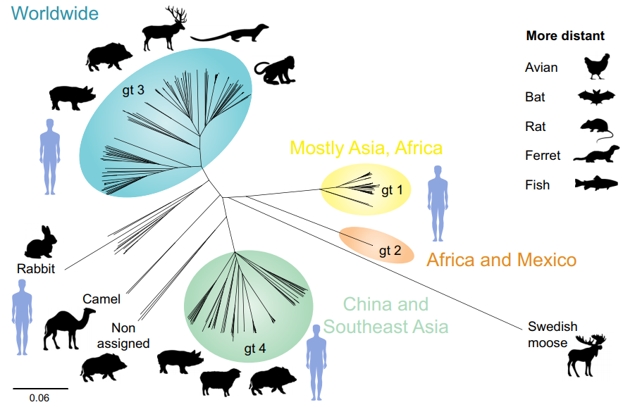
Phylogenetic relationship of hepeviruses identified in various hosts
Mostly Asia, Africa
China and
Southeast Asia
Debing Y, et al. J Hepatol 2016;65:200–12
Notes:
GT, genotype

Slide 14
HEV GT 1 and 2 in brief
~20 million infections worldwide
3 million symptomatic cases and 70,000 deaths/year*
WHO guidelines should be consulted for management of outbreaks of acute HEV in resource-limited settings
Brief, self-limiting, usually in young adults
Never chronic
Acute-on-chronic liver failure possible
High mortality in pregnancy (25%)
Recommendations
Travellers with hepatitis returning from areas endemic for HEV GT 1 or 2 should be tested for HEV | A | 1
Pregnant women with HEV GT 1 or 2 should be cared for in a high-dependency setting, and transferred to a liver transplant unit if liver failure occurs | A | 1
Level of evidence
Grade of recommendation
*Data from 2005 EASL CPG HEV. J Hepatol 2018;doi: 10.1016/j.jhep.2018.03.005 [Epub ahead of print]
Notes:
GT, genotype; WHO, World Health Organization

Slide 15
HEV GT 3 and 4: epidemiology
Endemic in some developing countries, as well as most high-income countries
Most common cause of acute viral hepatitis in many European countries
Estimated that ≥2 million locally acquired HEV infections/year
Most as a result of zoonotic infection
Primary hosts are pigs
HEV GT 3 and 4 tend to affect older males
In an English study, male:female ratio was 3:1; median age, 63 years¹
Incidence varies between and within countries, and over time
Multiple ‘hotspots’ of HEV infection in Europe
1. Dalton HR, et al. Eur J Gastroenterol Hepatol 2008;20:784–90; EASL CPG HEV. J Hepatol 2018;doi: 10.1016/j.jhep.2018.03.005 [Epub ahead of print]
Notes:
GT, genotype

Slide 16
HEV ‘hot spots’ in Europe
Scotland, 2016: 1:2,481 donors viraemic¹
SW France, 2016: incidence 3−4%²
The Netherlands, 2014: 1:600 donors viraemic³
Western Germany, 2015: 1:616 donors viraemic⁴
Czech Republic, 2015: 400 lab-confirmed cases⁵
Abruzzo, Italy, 2016: seroprevalence 49%⁶
Western/Central Poland, 2017: seroprevalence 50%⁷
1. Thom K, et al. Euro Surveill 2018;doi: 10.2807/1560-7917.ES.2018.23.12.17-00174 [Epub ahead of print]; 2. Mansuy JM, et al. Hepatology 2016;63:1145–54; 3. Zaaijer HL. Hepatology 2015;62:654; 4. Müller B, et al. Transfus Med Hemother 2015;42:1–66; 5. Adlhoch C, et al. J Clin Virol 2016;82:9–16; 6. Lucarelli C, et al. Euro Surveill 2016;21; 7. Bura M, et al, Int J Infect Dis. 2017; 61:20–2. EASL CPG HEV. J Hepatol 2018;doi: 10.1016/j.jhep.2018.03.005 [Epub ahead of print]

Slide 17
HEV ‘hot spots’ in Europe
Scotland, 2016: 1:2,481 donors viraemic¹
SW France, 2016: incidence 3−4%²
The Netherlands, 2014: 1:600 donors viraemic³
Western Germany, 2015: 1:616 donors viraemic⁴
Czech Republic, 2015: 400 lab-confirmed cases⁵
Abruzzo, Italy, 2016: seroprevalence 49%⁶
Western/Central Poland, 2018: seroprevalence 50%⁷
Worldwide HEV viraemia in blood donors
Australia, 2015: 1:14,799–74,131^{8,9}
Canada, 2017: 1:13,993¹⁰
China, 2016: 1:1,000¹¹
Japan, 2011: 1:8,173−15,075^{12,13}
USA, 2016: 1:9,500¹⁴
References included in slide notes. EASL CPG HEV. J Hepatol 2018;doi: 10.1016/j.jhep.2018.03.005 (and supplementary materials) [Epub ahead of print]
Notes:
1. Thom K, et al. Euro Surveill 2018;doi: 10.2807/1560-7917.ES.2018.23.12.17-00174 [Epub ahead of print]; 2. Mansuy JM, et al. Hepatology 2016;63:1145–54; 3. Zaaijer HL. Hepatology 2015;62:654; 4. Müller B, et al. Transfus Med Hemother 2015;42:1–66; 5. Adlhoch C, et al. J Clin Virol 2016;82:9–16; 6. Lucarelli C, et al. Euro Surveill 2016;21; 7. Bura M, et al, Int J Infect Dis. 2017; 61:20–2; 8. Shrestha AC, et al. Transfusion 2016;56:3086–93; 9. Hoad VC, et al. Vox Sang 2017;112:614–21; 10. Fearon MA, et al. Transfusion 2017;57:1420–5; 11. Zhang L, et al. Transfusion 2017;57:248–57; 12. Matsubayashi K, et al. ISBT Science Series 2011;6:344–9; 13. Minagi T, et al. Vox Sang 2016;111:242–6; 14. Stramer SL, et al. Transfusion 2015;56:481–8

Slide 18
Guidelines
Key recommendations

Slide 19
Topics
Click on a topic to skip to that section
Clinical aspects: acute infection
Clinical aspects: chronic infection
Extrahepatic manifestations
Laboratory diagnosis of HEV infection
Differential diagnosis
HEV and the blood supply
Treatment of acute HEV infection
Management of patients not clearing HEV infection
Prevention of HEV infection
Conclusions
EASL CPG HEV. J Hepatol 2018;doi: 10.1016/j.jhep.2018.03.005 [Epub ahead of print]

Slide 20
Clinical aspects: acute infection
Acute HEV GT 3 infection is clinically silent in most patients
<5% may develop symptoms of acute hepatitis
Elevated liver enzymes, jaundice and non-specific symptoms*
Immunocompetent patients clear the infection spontaneously
Progression to ALF is rare with HEV GT 3
ACLF occurs occasionally
Non-sterilizing immunity develops after infection has cleared
Re-infection possible, but with lower risk of symptomatic hepatitis
Recommendations
Should test for HEV in: All patients with symptoms consistent with acute hepatitis | A | 1
Suggest testing for HEV in: Patients with unexplained flares of chronic liver disease | C | 2
Level of evidence
Grade of recommendation
*Fatigue, itching and nausea EASL CPG HEV. J Hepatol 2018;doi: 10.1016/j.jhep.2018.03.005 [Epub ahead of print]
Notes:
ACLF, acute-on-chronic liver failue; ALF, acute liver failure; GT, genotype

Slide 21
Clinical aspects: chronic infection
Immunosuppressed patients can fail to clear HEV infection
Progression to chronic hepatitis*
Immunosuppressed groups include:
Solid organ transplant recipients
~50–66% of HEV-infected organ transplant recipients develop chronic hepatitis
Patients with haematological disorders
Individuals living with HIV
Patients with rheumatic disorders receiving heavy immunosuppression
Most patients are asymptomatic and present with mild and persistent LFT abnormalities
Recommendations
Should test for HEV in: All immunosuppressed patients with unexplained abnormal LFTs | A | 1
Grade of evidence
Grade of recommendation
*Persistence of HEV replication for 3 months. In rare cases, spontaneous clearance has been observed between 3 and 6 months EASL CPG HEV. J Hepatol 2018;doi: 10.1016/j.jhep.2018.03.005 [Epub ahead of print]
Notes:
HIV, human immunodeficiency virus; LFT, liver function test

Slide 22
Clinical aspects: chronic infection
Immunosuppressed patients can fail to clear HEV infection
Progression to chronic hepatitis*
Immunosuppressed groups include:
Solid organ transplant recipients
~50–66% of HEV-infected organ transplant recipients develop chronic hepatitis
Patients with haematological disorders
Individuals living with HIV
Patients with rheumatic disorders receiving heavy immunosuppression
Most patients are asymptomatic and present with mild and persistent LFT abnormalities
Chronic HEV has mainly been described
in the solid organ transplant setting
Recommendations
Should test for HEV in: All immunosuppressed patients with unexplained abnormal LFTs | A | 1
Grade of evidence
Grade of recommendation
*Persistence of HEV replication for 3 months. In rare cases, spontaneous clearance has been observed between 3 and 6 months EASL CPG HEV. J Hepatol 2018;doi: 10.1016/j.jhep.2018.03.005 [Epub ahead of print]
Notes:
HIV, human immunodeficiency virus; LFT, liver function test

Slide 23
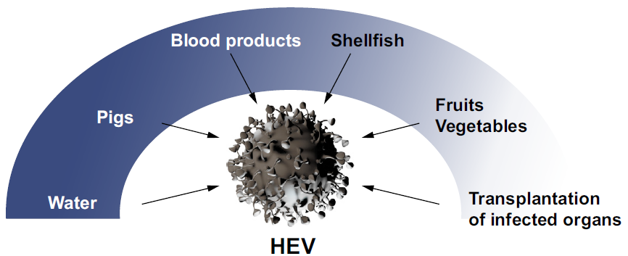
Transmission and disease progression in transplanted individuals
Solid organ transplanted individual
40−50%
50−60%*
Clearance
Chronic infection
Cirrhosis
~10% rapid progression
Death
Need for LTx
*Possible increased likelihood for LTx recipients, only GT 3 Behrendt P, et al. J Hepatol 2014;61:1418–29
Notes:
GT, genotype; LTx, liver transplantation

Slide 24
Extrahepatic manifestations
Extrahepatic manifestations of HEV are increasingly recognized
Organ system | Clinical syndrome | Notes
Neurological | Neuralgic amyotrophy* Guillain–Barré syndrome* Meningoencephalitis* Mononeuritis multiplex Myositis Bell’s palsy, vestibular neuritis, and peripheral neuropathy | ~150 cases of neurological injury (in HEV GT 3); mainly Europe Most (>90%) cases in the immunocompetent
Renal* | Membranoproliferative and membranous glomerulonephritis IgA nephropathy | Mainly immunosuppressed GT 3-infected patients Renal function improves and proteinuria levels decrease following HEV clearance
Haematological | Thrombocytopenia Monoclonal immunoglobulin Cryoglobulinaemia Aplastic anaemia† Haemolytic anaemia† | Mild thrombocytopenia is common; occasionally severe Reported in 25% of cases of acute HEV in UK study Occurs mainly in association with renal disease
Other | Acute pancreatitis Arthritis† Myocarditis† Autoimmune thyroiditis† | 55 cases worldwide. HEV GT 1 only; usually mild
*There is good evidence to support a causal role for HEV and these associated conditions. For the other extrahepatic manifestations, causality remains to be established; †Case reports only EASL CPG HEV. J Hepatol 2018;doi: 10.1016/j.jhep.2018.03.005 [Epub ahead of print]
Notes:
GT, genotype; IgA, immunoglobulin A

Slide 25
Extrahepatic manifestations
Extrahepatic manifestations of HEV are increasingly recognized
Organ system | Clinical syndrome | Notes
Neurological | Neuralgic amyotrophy* Guillain–Barré syndrome* Meningoencephalitis* Mononeuritis multiplex Myositis Bell’s palsy, vestibular neuritis, and peripheral neuropathy | ~150 cases of neurological injury (in HEV GT 3); mainly Europe Most (>90%) cases in the immunocompetent
Renal* | Membranoproliferative and membranous glomerulonephritis IgA nephropathy | Mainly immunosuppressed GT 3-infected patients Renal function improves and proteinuria levels decrease following HEV clearance
Haematological | Thrombocytopenia Monoclonal immunoglobulin Cryoglobulinaemia Aplastic anaemia† Haemolytic anaemia† | Mild thrombocytopenia is common; occasionally severe Reported in 25% of cases of acute HEV in UK study Occurs mainly in association with renal disease
Other | Acute pancreatitis Arthritis† Myocarditis† Autoimmune thyroiditis† | 55 cases worldwide. HEV GT 1 only; usually mild
Most important
*There is good evidence to support a causal role for HEV and these associated conditions. For the other extrahepatic manifestations, causality remains to be established; †Case reports only EASL CPG HEV. J Hepatol 2018;doi: 10.1016/j.jhep.2018.03.005 [Epub ahead of print]
Notes:
GT, genotype; IgA, immunoglobulin A

Slide 26
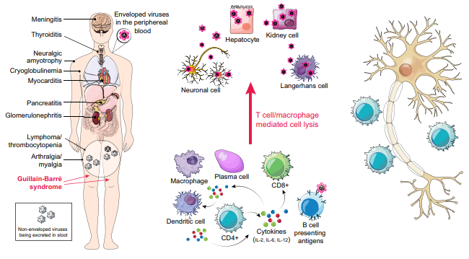
Extrahepatic manifestations
Reported extrahepatic organ
manifestations in the context of
hepatitis E virus infection
Possible mechanisms of
extrahepatic symptoms
in the context of HEV replication
Possible mechanisms of
neurological manifestations
in the absence of HEV replication
Pischke S, et al. J Hepatol 2017;66:1082–95
Notes:
IL, interleukin

Slide 27
Extrahepatic manifestations
Existence of extrahepatic manifestations of HEV means that testing is warranted in a number of patient populations
Grade of evidence
Grade of recommendation
Recommendations
Testing for HEV recommended in:*
Patients with neuralgic amyotrophy | B | 1
Patients with Guillain–Barré syndrome | B | 1
Testing for HEV suggested in: Patients with encephalitis/myelitis | C | 2
Testing for proteinuria suggested in: HEV-infected patients | C | 2
Patients with acute or chronic HEV infection who develop new-onset proteinuria may be considered for a renal biopsy | C | 2
Treatment Antiviral treatment suggested for patients with chronic HEV infection and associated glomerular disease | C | 2
*Irrespective of LFT results EASL CPG HEV. J Hepatol 2018;doi: 10.1016/j.jhep.2018.03.005 [Epub ahead of print]
Notes:
LFT, liver function test

Slide 28
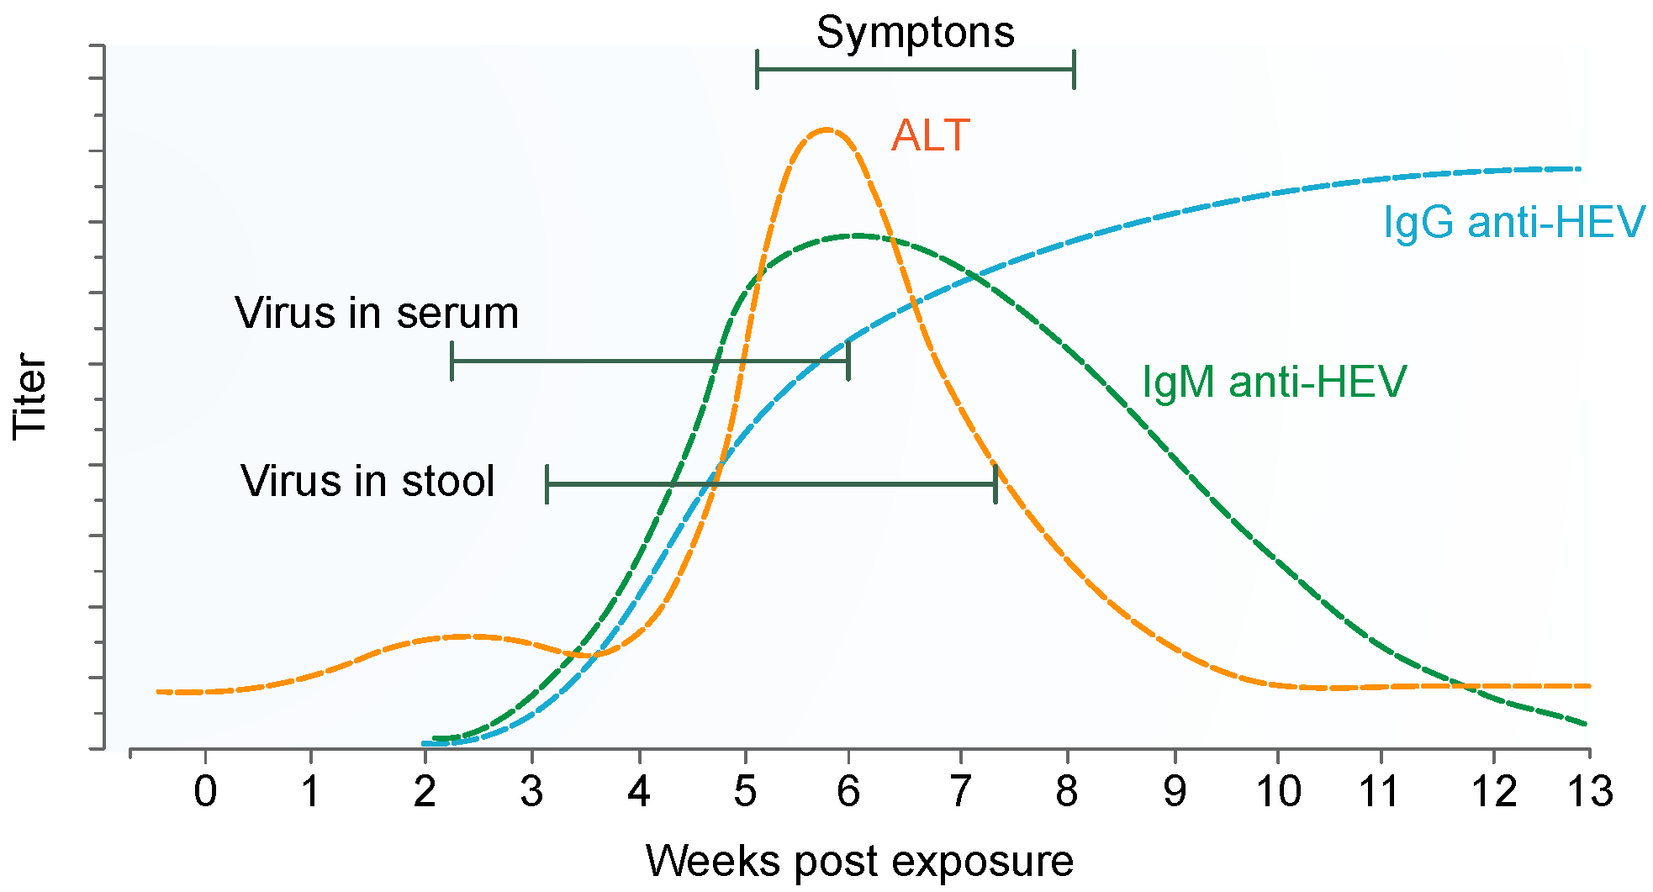
Laboratory diagnosis of HEV infection
Incubation period for HEV is ~15–60 days
HEV RNA is detected ~3 weeks post-infection in blood and stool
Shortly before onset of symptoms
At clinical onset biochemical markers become elevated
First IgM followed by IgG
EASL CPG HEV. J Hepatol 2018;doi: 10.1016/j.jhep.2018.03.005 [Epub ahead of print]
Notes:
ALT, alanine aminotransferase; Ig, immunoglobulin

Slide 29
Laboratory diagnosis of HEV infection
Acute HEV infection can be diagnosed by detection of anti-HEV antibodies
IgM, IgG or both by enzyme immunoassays in combination with HEV NAT
Serological testing relies upon detection of anti-IgM and (rising) IgG
Infection status | Positive markers
Current infection – acute | HEV RNA HEV RNA + anti-HEV IgM HEV RNA + anti-HEV IgG* HEV RNA + anti-HEV IgM + anti-HEV IgG Anti-HEV IgM + anti-HEV IgG (rising) HEV antigen
Current infection – chronic | HEV RNA (± anti-HEV) ≥3 months HEV antigen
Past infection | Anti-HEV IgG
*Patients with re-infection are typically anti-HEV IgM negative, but IgG and PCR positive EASL CPG HEV. J Hepatol 2018;doi: 10.1016/j.jhep.2018.03.005 [Epub ahead of print]
Notes:
Ig, immunoglobulin; NAT, nucleic acid test; PCR, polymerase chain reaction

Slide 30
Molecular analysis of HEV
Detection of HEV RNA in blood or stool is indicative of HEV infection
In immunosuppressed patients with chronic HEV, anti-HEV antibodies are often undetectable
NATs are the only reliable means of diagnosis
In chronic cases, viral load testing should be used
To evaluate patient response to treatment
To identify relapsing infections
Recommendations
A combination of serology and NAT testing should be used to diagnose HEV infection | A | 1
NAT testing should be used to diagnose chronic HEV infection | A | 1
Grade of evidence
Grade of recommendation
EASL CPG HEV. J Hepatol 2018;doi: 10.1016/j.jhep.2018.03.005 [Epub ahead of print]
Notes:
NAT, nucleic acid test

Slide 31
Diagnostic algorithm for HEV infection
Elevated liver enzymes
Immunocompetent
Immunocompromised
Anti-HEV-IgM (and IgG)
and HEV RNA
HEV RNA ± serology
Positive
Positive
Acute hepatitis E
Extrahepatic
manifestation?
HEV-infection
Pre-existing
chronic liver disease?
HEV RNA positive >3 months?
Acute-on-chronic liver failure?
Chronic hepatitis E
Transplant-centre?
Ribavirin?
Serology and NAT testing are best used in combination, as a negative PCR does not exclude acute infection; serology is sometimes negative in immunosuppressed patients with chronic infection EASL CPG HEV. J Hepatol 2018;doi: 10.1016/j.jhep.2018.03.005 [Epub ahead of print]
Notes:
Ig, immunoglobulin; NAT, nucleic acid test; PCR, polymerase chain reaction

Slide 32
Differential diagnosis
Diagnosis of HEV in some instances can problematic
Infection status | Differential diagnosis
Acute infection* | Drug-induced liver injury (DILI) Autoimmune hepatitis (AIH) Acute hepatitis E Seronegative hepatitis EBV hepatitis Acute hepatitis B Acute hepatitis A Acute hepatitis C CMV hepatitis
Chronic infection in immunosuppressed individuals | Graft rejection Drug-induced liver injury Recurrence of primary liver pathology in LTx recipients Graft vs. host disease Intercurrent infections; e.g. sepsis Chronic hepatitis E EBV and CMV reactivation
*The differential diagnosis is in order of frequency of each condition seen at a rapid-access jaundice clinic in Southwest England EASL CPG HEV. J Hepatol 2018;doi: 10.1016/j.jhep.2018.03.005 [Epub ahead of print]
Notes:
CMV, cytomegalovirus; EBV, Epstein–Barr virus; LTx, liver transplantation

Slide 33
Differential diagnosis
Diagnosis of HEV in some instances can problematic
Infection status | Differential diagnosis
Acute infection* | Drug-induced liver injury (DILI) Autoimmune hepatitis (AIH) Acute hepatitis E Seronegative hepatitis EBV hepatitis Acute hepatitis B Acute hepatitis A Acute hepatitis C CMV hepatitis
Chronic infection in immunosuppressed individuals | Graft rejection Drug-induced liver injury Recurrence of primary liver pathology in LTx recipients Graft vs. host disease Intercurrent infections; e.g. sepsis Chronic hepatitis E EBV and CMV reactivation
In elderly patients, many of whom will be on multiple medications, HEV infection is often misdiagnosed as DILI
*The differential diagnosis is in order of frequency of each condition seen at a rapid-access jaundice clinic in Southwest England EASL CPG HEV. J Hepatol 2018;doi: 10.1016/j.jhep.2018.03.005 [Epub ahead of print]
Notes:
CMV, cytomegalovirus; EBV, Epstein–Barr virus; LTx, liver transplantation

Slide 34
Differential diagnosis
Diagnosis of HEV in some instances can problematic
Infection status | Differential diagnosis
Acute infection* | Drug-induced liver injury (DILI) Autoimmune hepatitis (AIH) Acute hepatitis E Seronegative hepatitis EBV hepatitis Acute hepatitis B Acute hepatitis A Acute hepatitis C CMV hepatitis
Chronic infection in immunosuppressed individuals | Graft rejection Drug-induced liver injury Recurrence of primary liver pathology in LTx recipients Graft vs. host disease Intercurrent infections; e.g. sepsis Chronic hepatitis E EBV and CMV reactivation
In elderly patients, many of whom will be on multiple medications, HEV infection is often misdiagnosed as DILI
It is also difficult to distinguish AIH and acute HEV; AIH autoantibodies can produce false-positive HEV results
*The differential diagnosis is in order of frequency of each condition seen at a rapid-access jaundice clinic in Southwest England. EASL CPG HEV. J Hepatol 2018;doi: 10.1016/j.jhep.2018.03.005 [Epub ahead of print]
Notes:
CMV, cytomegalovirus; EBV, Epstein–Barr virus; LTx, liver transplantation

Slide 35
Broadening testing for HEV
Previously, only patients travelling to areas in Africa and Africa hyperendemic for HEV GT 1 or 2 were considered for testing
Now know that most HEV infection is locally acquired
All patients presenting with hepatitis should be tested*
Irrespective of travel history
Immunological status | Patients who should be tested for HEV
Immunocompetent | Any patient with biochemical evidence of hepatitis* Suspected drug-induced liver injury* Decompensated chronic liver disease† Neuralgic amyotrophy† Guillain–Barré syndrome† Encephalitis† Patients with unexplained acute neurology and raised ALT‡
Immunocompromised (developed countries) | As above Persistently abnormal ALT§
*Grade of evidence A, Grade of recommendation 1; †Testing should be done at disease onset, irrespective of ALT results; ‡Testing should be done at disease onset if ALT is abnormal; §If ALT is above the limit of normal on more than one occasion EASL CPG HEV. J Hepatol 2018;doi: 10.1016/j.jhep.2018.03.005 [Epub ahead of print]
Notes:
ALT, alanine aminotransferase; GT, genotype

Slide 36
HEV and the blood supply
HEV can also be transmitted iatrogenically
Through infected blood and blood products
Universal, targeted or partial screening for HEV in donors:
Ireland, the UK, the Netherlands, and Japan
Germany: voluntary HEV screening by some blood transfusion companies
Recommendations
Patients with abnormal LFTs after receiving blood products should be tested for HEV | A | 1
Blood donor screening Blood donor services should screen blood donors for HEV by NAT, informed by local risk assessment and cost-effectiveness studies | A | 1
Grade of evidence
Grade of recommendation
EASL CPG HEV. J Hepatol 2018;doi: 10.1016/j.jhep.2018.03.005 [Epub ahead of print]
Notes:
LFT, liver function test; NAT, nucleic acid test

Slide 37
Treatment of acute HEV infection
Acute HEV infection does not usually require antiviral therapy*
Most cases of HEV infection are spontaneously cleared
Some patients may progress to liver failure
Ribavirin
Early therapy of acute HEV may shorten course of disease and reduce overall morbidity
Recommendation
Ribavirin treatment may be considered in cases of severe acute hepatitis or acute-on-chronic liver failure | C | 2
Grade of evidence
Grade of recommendation
*Grade of evidence A EASL CPG HEV. J Hepatol 2018;doi: 10.1016/j.jhep.2018.03.005 [Epub ahead of print]

Slide 38
Reduction of immunosuppression as first therapeutic step in solid organ transplant recipients
Solid organ transplanted individual
40−50%
50−60%*
Clearance
Chronic infection
Cirrhosis
~10% rapid progression
Death
Need for LTx
*Possible increased likelihood for LTx recipients, only GT 3 Behrendt P, et al. J Hepatol 2014;61:1418–29
Notes:
GT, genotype; LTx, liver transplantation

Slide 39
Reduction of immunosuppression as first therapeutic step in solid organ transplant recipients
Solid organ transplanted individual
40−50%
50−60%*
Clearance
Chronic infection
HEV is cleared in ~30% of patients by reducing immunosuppression
Cirrhosis
~10% rapid progression
Death
Need for LTx
*Possible increased likelihood for LTx recipients, only GT 3 Behrendt P, et al. J Hepatol 2014;61:1418–29
Notes:
GT, genotype; LTx, liver transplantation

Slide 40
Management of patients not clearing HEV infection
Chronic HEV infection
Reduction of immunosuppression
HEV clearance
No HEV clearance
3-month course of ribavirin monotherapy
Serum and stool
HEV RNA negative
Relapse after
ceasing ribavirin
6-month course of
ribavirin monotherapy
No response to
ribavirin or intolerant
Persistent HEV replication in serum or HEV relapse
Pegylated interferon for 3 months in LTx patients
No alternative available therapy in other transplant patients
EASL CPG HEV. J Hepatol 2018;doi: 10.1016/j.jhep.2018.03.005 [Epub ahead of print]
Notes:
LTx, liver transplantation

Slide 41
Management of HEV infection
Recommendations
Decrease immunosuppression at diagnosis of chronic HEV infection in solid organ transplant recipients, if possible | B | 1
Give ribavirin for 12 weeks in patients with persisting HEV replication 3 months after detection of HEV RNA | B | 1
Monitoring of HEV RNA Assess in serum and stool at the end of scheduled period of ribavirin therapy Stop ribavirin if undetectable in both serum and stool | B C | 1 2
Grade of evidence
Grade of recommendation
EASL CPG HEV. J Hepatol 2018;doi: 10.1016/j.jhep.2018.03.005 [Epub ahead of print]

Slide 42
Management of HEV infection
Optimal treatment duration in patients who test HEV RNA positive after 4 or 8 weeks of therapy and who are HEV RNA negative after 12 weeks of therapy is unknown*
Optimal therapeutic approach unknown in patients who show no response to ribavirin and/or who relapse after retreatment*
Recommendations
If HEV RNA is still detectable in serum and/or stool after 12 weeks, ribavirin monotherapy may be continued for an additional 3 months (6 months therapy overall) | C | 2
Liver transplant recipients who show no response to ribavirin can be considered for treatment with pegylated interferon-α | C | 2
Grade of evidence
Grade of recommendation
*Grade of evidence C EASL CPG HEV. J Hepatol 2018;doi: 10.1016/j.jhep.2018.03.005 [Epub ahead of print]

Slide 43
Prevention of HEV infection
Consumption of undercooked meat from pigs, wild boar, and deer is a clear risk factor for HEV infection in Europe
In vitro food preparation data inconclusive
Risk of patient-to-patient transmission is poorly defined
Sexual transmission has been described in MSM
Stool contains high amounts of infectious HEV particles
Strict hygiene is required
A vaccine has been developed but is only licensed in China
Recommendations
Immunocompromised individuals and those with chronic liver diseases should avoid consumption of undercooked meat (pork, wild boar and venison) and shellfish | B | 1
Suggested that immunocompromised patients consume meat only if it has been thoroughly cooked to ≥70°C | B | 2
Grade of evidence
Grade of recommendation
EASL CPG HEV. J Hepatol 2018;doi: 10.1016/j.jhep.2018.03.005 [Epub ahead of print]
Notes:
MSM, men who have sex with men

Slide 44
Conclusions
Unanswered questions and perspectives

Slide 45
Conclusions
Understanding of HEV infection has changed dramatically in the last decade
Infection with HEV represents an important global public health problem and is a cause of significant morbidity and mortality worldwide
There are still many knowledge gaps
CPGs will require amendment in a few years’ time with further research and evolving evidence
EASL CPG HEV. J Hepatol 2018;doi: 10.1016/j.jhep.2018.03.005 [Epub ahead of print]

